Slide 1

Episode 1

Slide 2
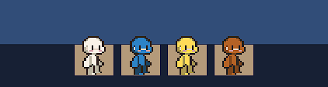
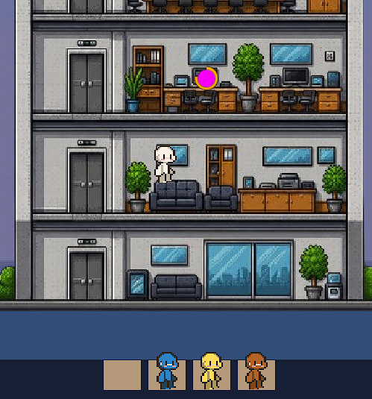
Episode 1 directions
1
2
This are the operators you’re going to use this to complete task How??
Press and Drag the operators to the circular task to operate.

Slide 3
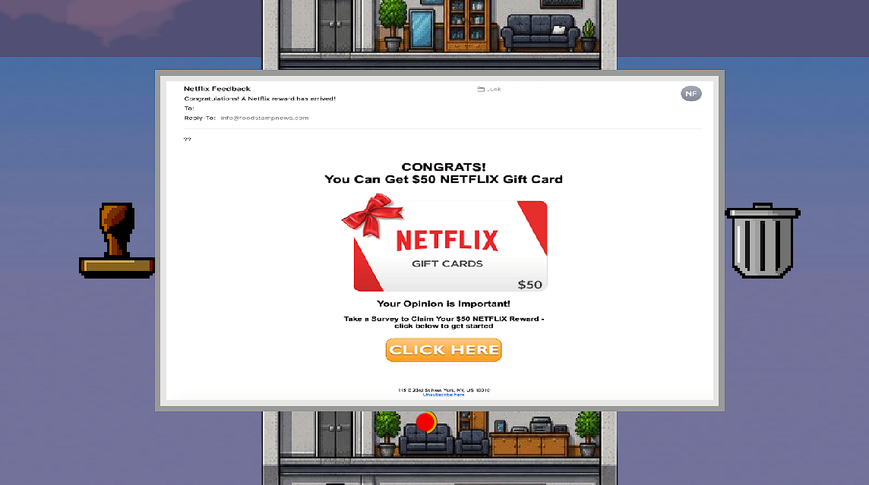
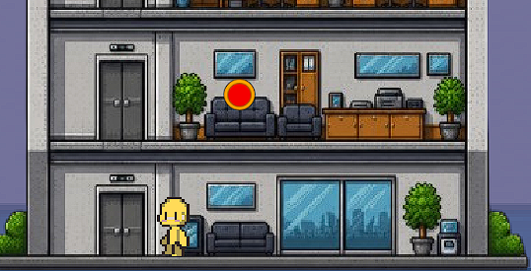
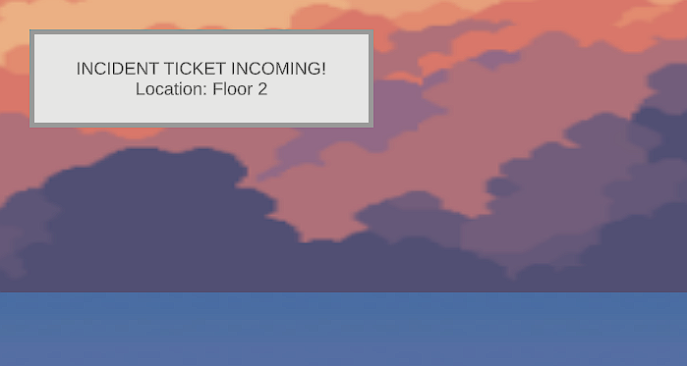
Episode 1 directions
5
3
The user will be ask to mark as approve or go to the trash bin
If the you successfully drag the operators to the operator will walk and use the elevator to go what floor the task is.
4

Slide 4

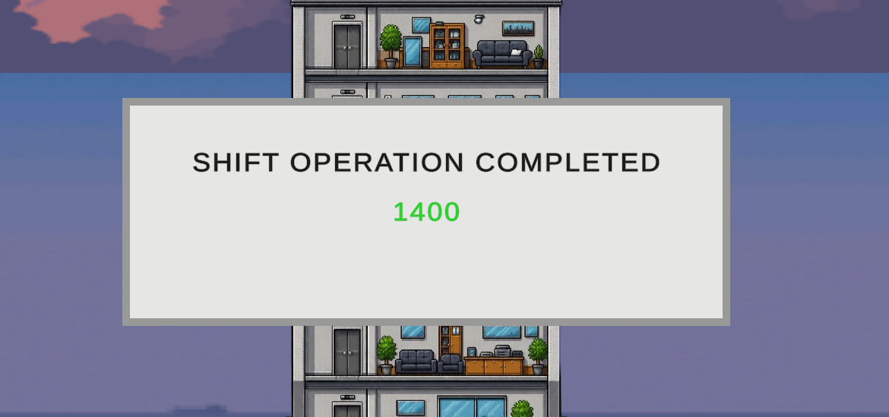
Episode 1 directions
6
If the user are correct they will receive 100points
And each questions are 100points and task will appear in a pattern
6
If the operation is completed the score will be added to your account

